Slide 1
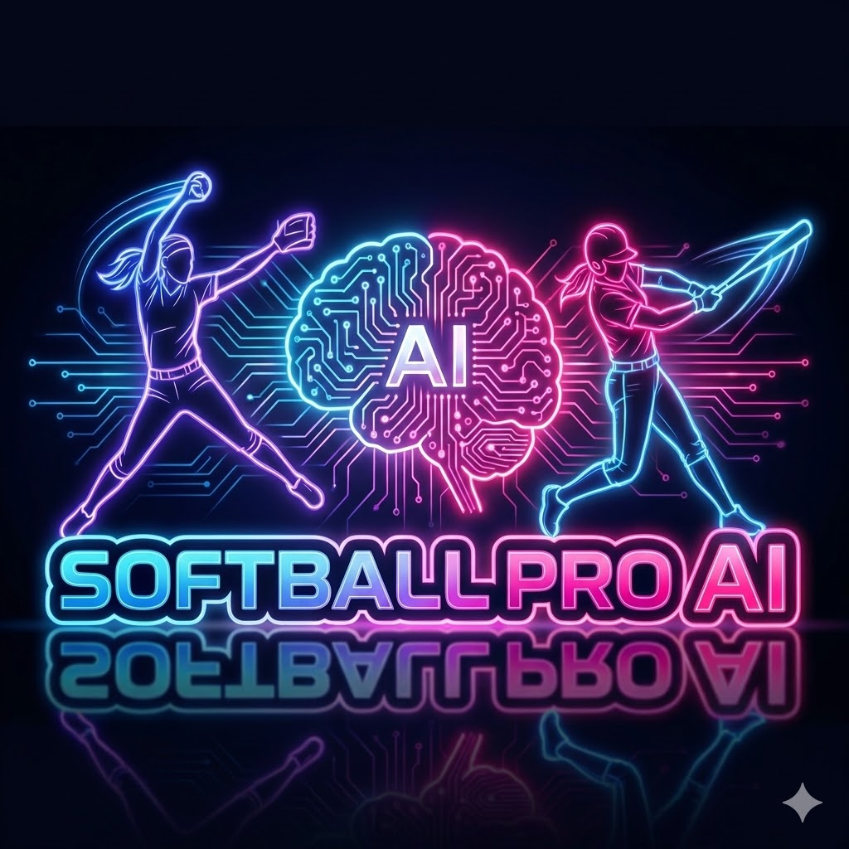
AI-Powered Coaching for Every Athlete
Seed Round: $50K | February 2026

Slide 2
The Journey
For 3 years, I have walked 5 miles daily.
Not because I want to - because I have to.
30 years fighting undiagnosed chronic illness
13 years sober, raising daughter Shannon alone
1.5 hours daily learning AI, biomechanics, coaching
Built SoftballProAI on that treadmill
"If I stop moving, I give up. Shannon is watching."

Slide 3
The Problem
$2.5B Market, Broken Coaching System
2.5M youth softball players in the US
Parents spend $3,800/year per athlete
Elite coaching costs $100-200/hour
Most athletes get fragmented volunteer coaching
Athletes have AI tutors for everything EXCEPT sports

Slide 4
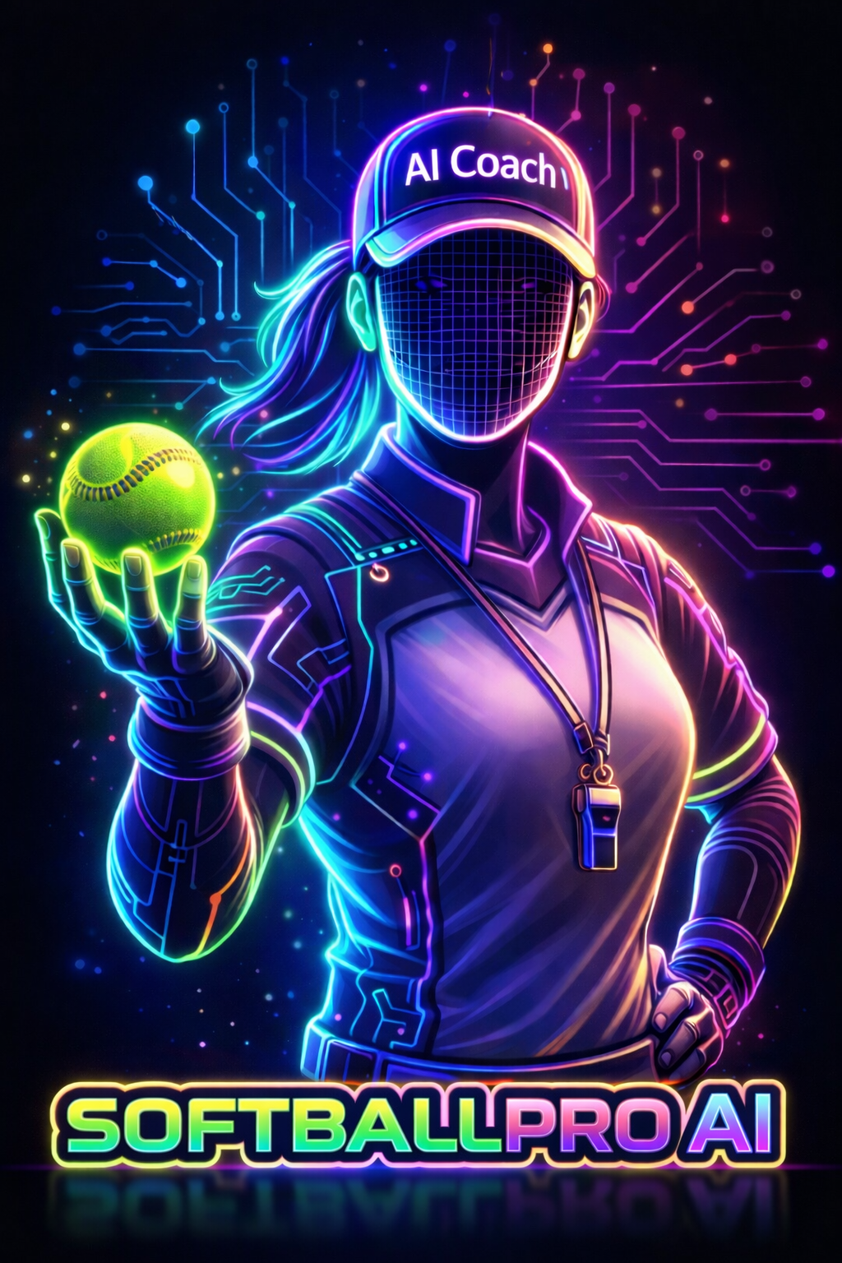
The Solution
AI Brain with real softball knowledge
Live Coach real-time video analysis
Head Coach AI auto-scoring
Personalized training programs
Instructor marketplace
Mental training & psychology

Slide 5
HEAD COACH AI
The GameChanger Killer
AI watches game via phone camera
Automatically scores every play
Real-time stats and coaching insights
Auto-generated highlight reels
Parents supervise. AI does the work.

Slide 6
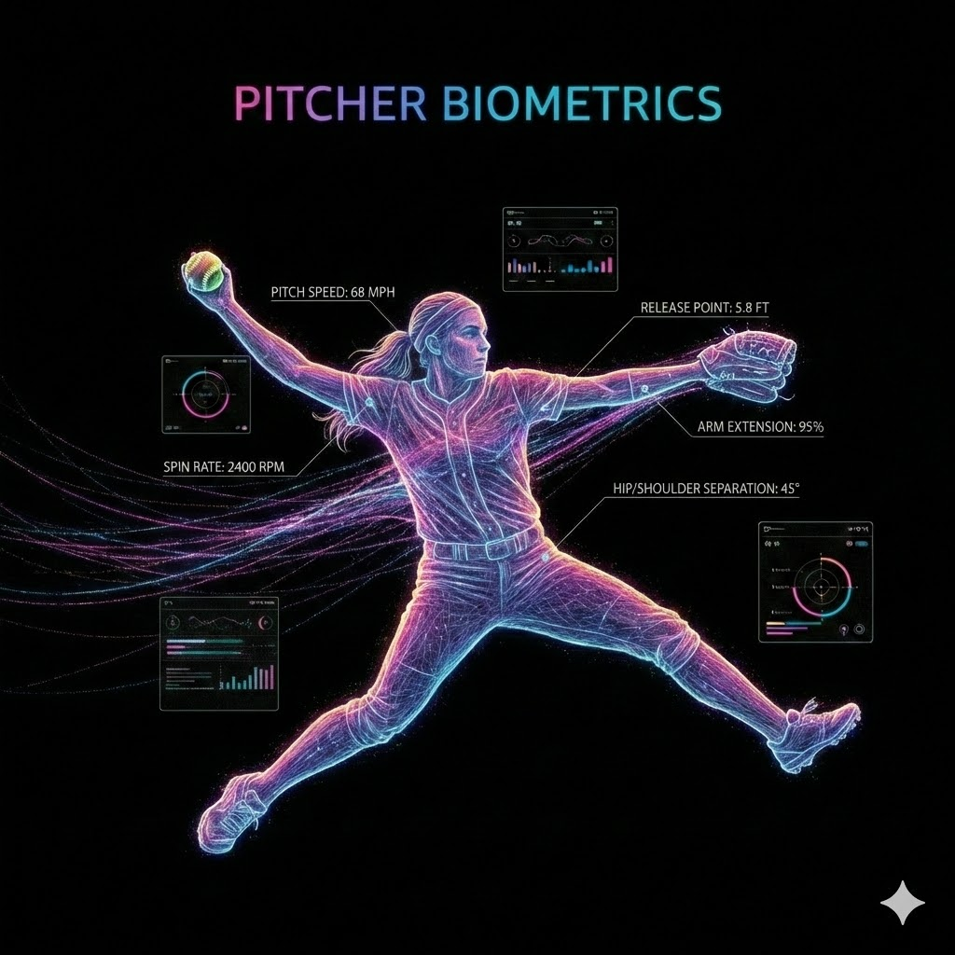

Slide 7
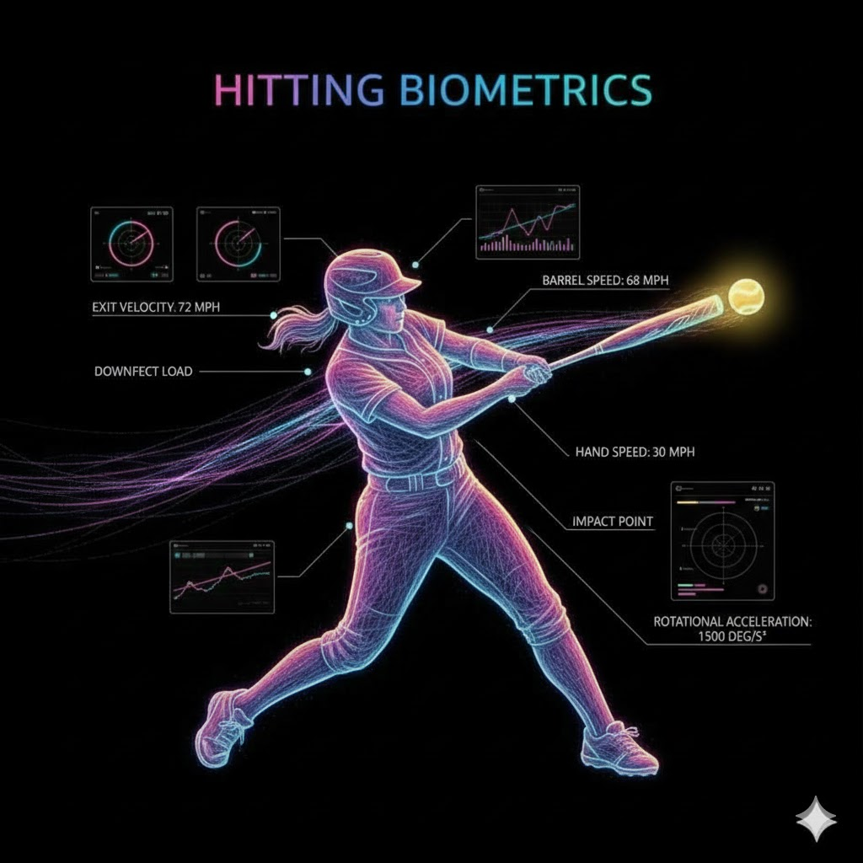

Slide 8
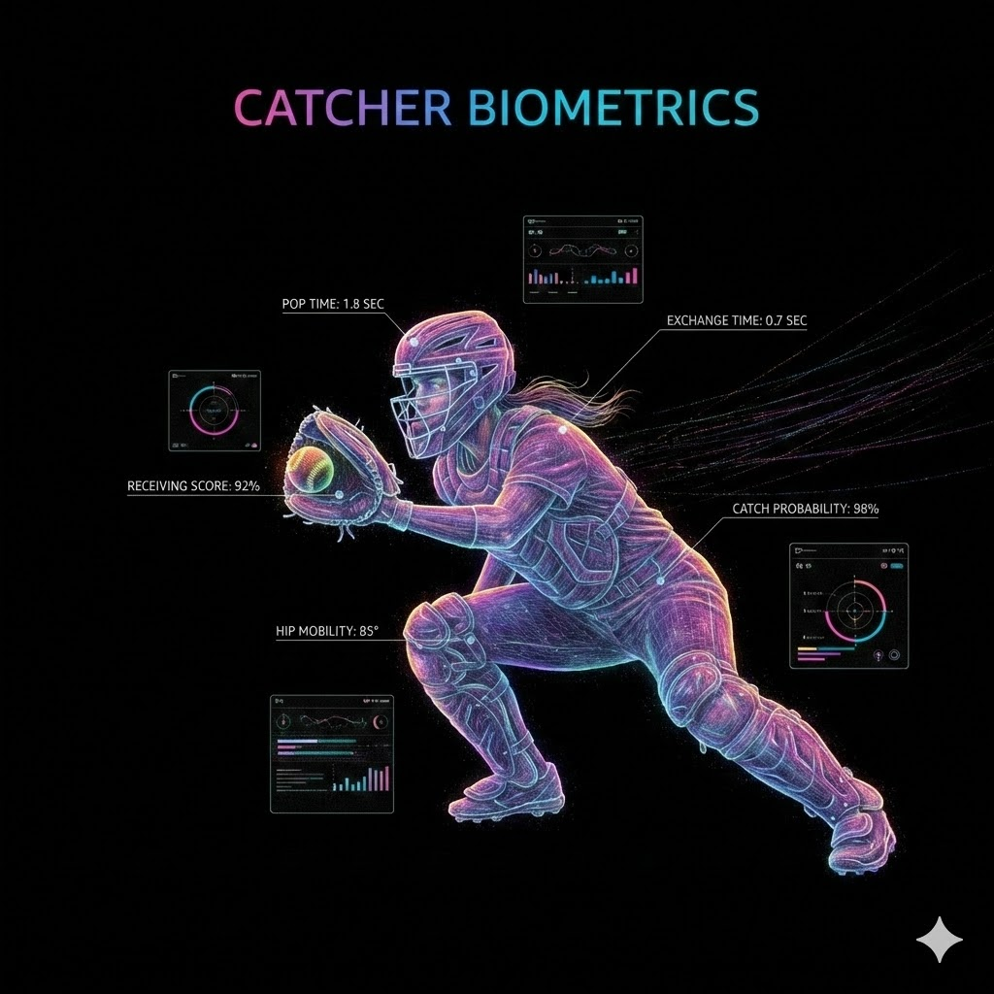

Slide 9
Market Opportunity
TAM: $2.5B youth sports training
SAM: $500M AI-powered coaching
SOM: $50M initial softball focus
Head Coach AI Market Impact:
GameChanger: 8M+ users at $9.99-19.99/mo
Our pricing: $99.99/mo with AI automation
5% capture = 200K teams = $20M ARR

Slide 10
Traction (Pre-Launch)
85%
50 beta users
ASA partnership talks
Weekly Active Users
GameChanger integration
(Industry: 20-30%)
Production-ready stack

Slide 11
Revenue Model
Player: $14.99/mo
Full AI coaching, video analysis, personalized training
Private Instructor: $49.99/mo
Marketplace access, student management, AI tools
Team Coach: $99.99/mo
Head Coach AI, team analytics, roster management

Slide 12
Path to $50K MRR (Q2 2026)
1,000 players x $14.99 = $14,990
200 instructors x $49.99 = $9,998
250 teams x $99.99 = $24,997
Total MRR: $49,985
Year 1: $20K ARR | Year 2: $1.2M ARR | Year 3: $4.8M ARR
Breakeven: Q3 2026

Slide 13
Competitive Advantage
Competitors: Rapsodo, Blast, Zepp (expensive hardware)
GameChanger (manual scoring only)
Our Advantages:
AI with continuous learning from real coaching data
Mobile-first, no expensive hardware
Two-sided marketplace (athletes + instructors)
Automated scoring + coaching insights

Slide 14
Why Me
Kimberly A. Tarnovska, Founder & CEO
20+ years hospitality accounting & audit
Self-taught AI/data science, predicted AI revolution
Softball parent/coach, lives the pain point
30 years fighting dismissal by medical experts
13 years sober - discipline and systems
Walks 5 miles daily learning while in pain
This combination exists nowhere else.

Slide 15
THE ASK
$50K Seed Round
40% Product ($20K)
30% Marketing ($15K)
20% Operations ($10K)
10% Team ($50K)

Slide 16
I have walked 5,475 miles building this.
Let me show you where those miles lead.

